Slide 1




News story classification with Python and Weka

Slide 2


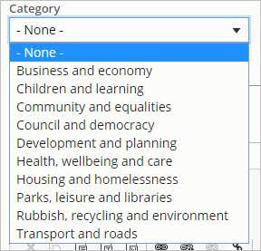

The problem
Comms want to classify news stories so site visitors can browse by category
Stories in the news feed would also display a tag with the category they belong to
10 categories, based on old stories
Category set on new stories, not old ones
How to classify the old stories?

Slide 3


Obtaining the data

Slide 4
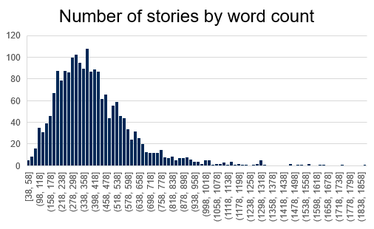
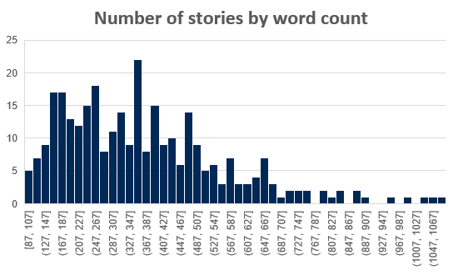
Metrics
 | Stories | Unique words | Total words | Average words | Classes
Uncategorised | 2039 | 20700 | 827K | 300-400 | 10
Categorised | 309 | 8800 | 115K | 350-375 | 10

Slide 5
Using machine learning to solve the problem
Text classification only possible with largish number of stories.
Jan – 13
March – 73
Now – 309
Software?
Python NLTK
Weka
R?
SAP Predictive Analysis?

Slide 6

Jupyter Notebook
https://jupyter.org/

Slide 7


Weka
https://www.cs.waikato.ac.nz/ml/weka/

Slide 8
Text classification workflow
Gather data
Explore the data
Prepare the data
Choose a model
Build, train and evaluate the model
Tune the model
Deploy the model

Slide 9
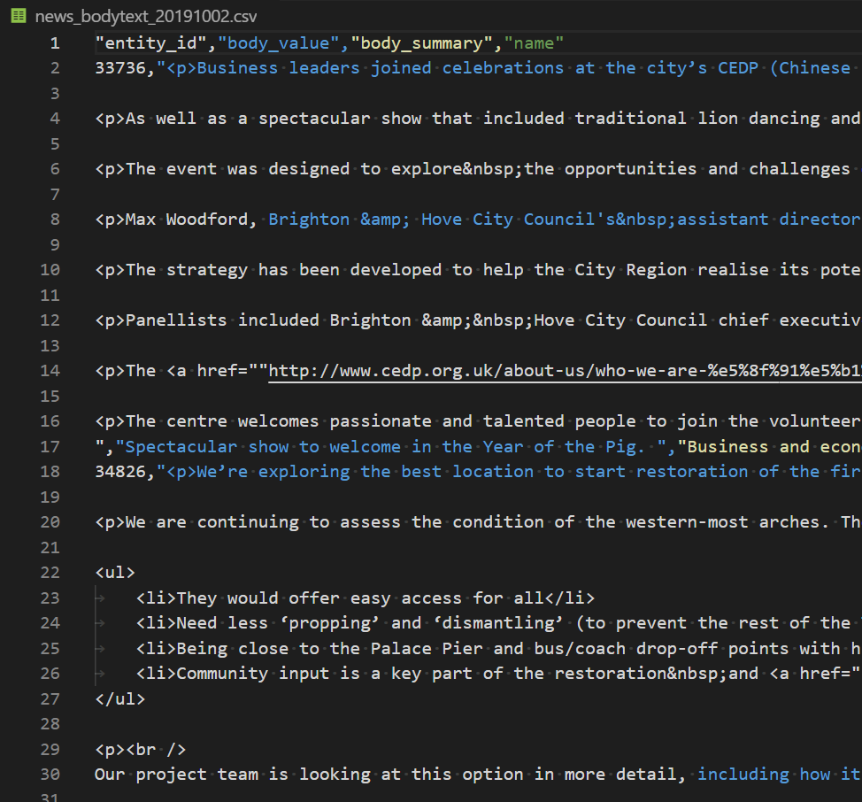

Cleaning the data

Slide 10
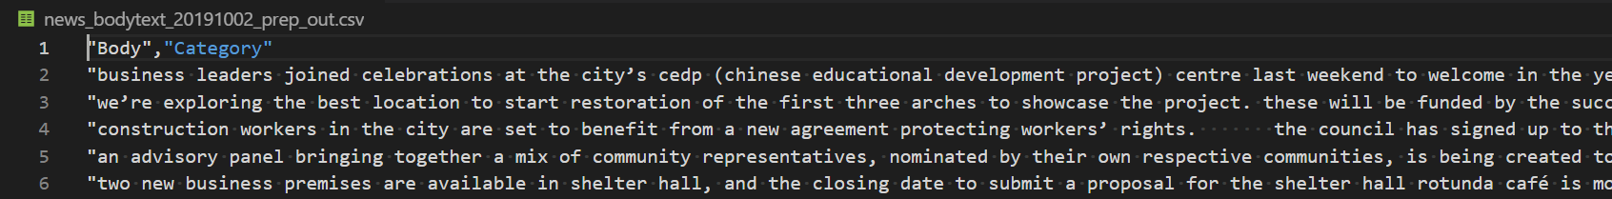
Data preparation
Remove all the formatting
End up with a simple string
This is done in Python with Jupyter Notebook
Then it’s ready for processing in Weka

Slide 11
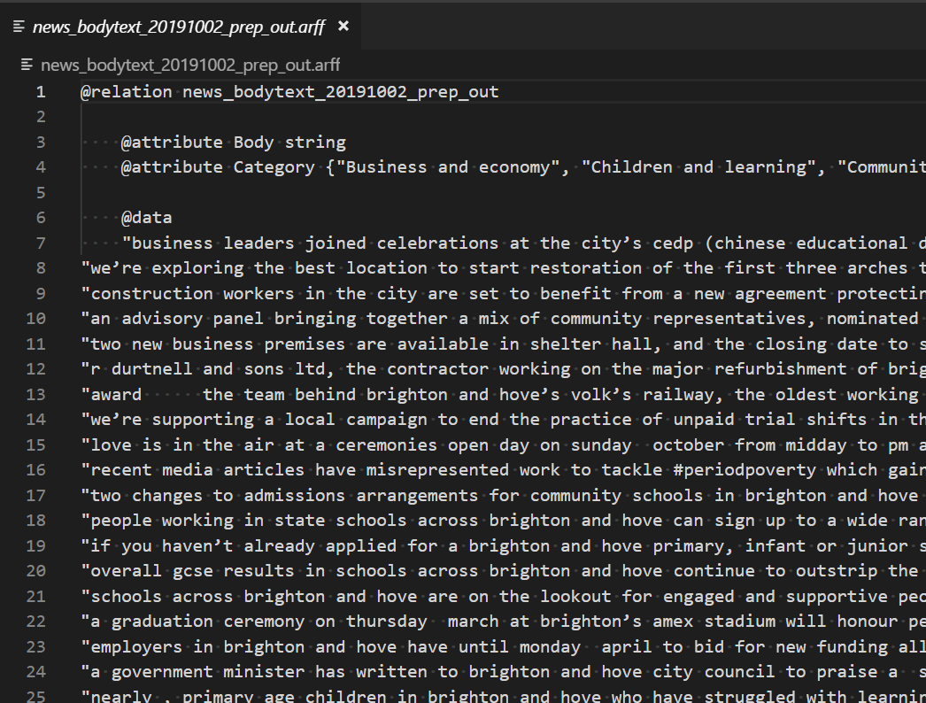
Data preparation – arff format for Weka
Get the data into the right format for Weka (arff)
It’s two columns
Body
Category
(My script that does this isn’t working on Windows ☹)

Slide 12
Weka preprocessing
Use the “Text to word vector” filter to turn the body text into a list of words
Options
Stop words – none or ‘rainbow’
Words to keep per class – 20, 50, 100, 200, 500, 1000
Word count – incidence or frequency
How do the options affect classification?
Stop words help
Word presence (0/1) is better than word frequency

Slide 13
Classification
Models
ZeroR (classify everything as the most popular class - baseline)
OneR (just use one attribute – not too good for 10 classes!)
J48 Tree (see https://en.wikipedia.org/wiki/C4.5_algorithm)
Naïve Bayes (https://en.wikipedia.org/wiki/Naive_Bayes_classifier)
This is a popular text classifier
It uses attribute probabilities and assumes the attributes are independent
In our model, the attributes are the words in the article

Slide 14
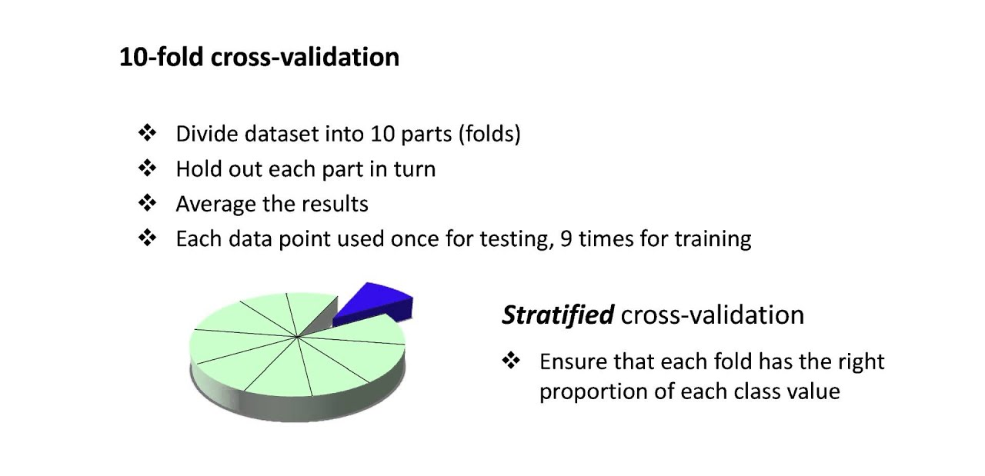
Training and testing the model
I don’t have separate training and test sets so I am using 10-fold cross validation

Slide 15
Word vector options
Number of words to keep (per category)
Stopwords (exclude common words, a, the, it, an, etc)
Stemming (chopping similar words, chopped, chop)
Word presence or frequency
etc

Slide 16
Comparing different ways of preparing the data
Test | correct | test | correct | test | correct
no_stop_1000 | 74.79 | rainbow_1000 | 75.35 | rainbow_1000_freq | 67.74
no_stop_500 | 76.54 | rainbow_500 | 77.12 | rainbow_500_freq | 68.42
no_stop_200 | 74.57 | rainbow_200 | 75.96 | rainbow_200_freq | 69.23
no_stop_100 | 71.37 | rainbow_100 | 74.66 | rainbow_100_freq | 70.23
no_stop_50 | 64.8 | rainbow_50 | 72.63 | rainbow_50_freq | 70.22
no_stop_20 | 42.66 | rainbow_20 | 66.64 | rainbow_20_freq | 64.95
Notes:
Use the weka experimenter to run the same or similar tests together, and compare results.
Found that rainbow 500 was best, hitting 77%

Slide 17
Applying the model to uncategorised data
I’m using
Naïve Bayes
Rainbow stop words
500 word per category
(2971 words total)
How good is it?

